Slide 1
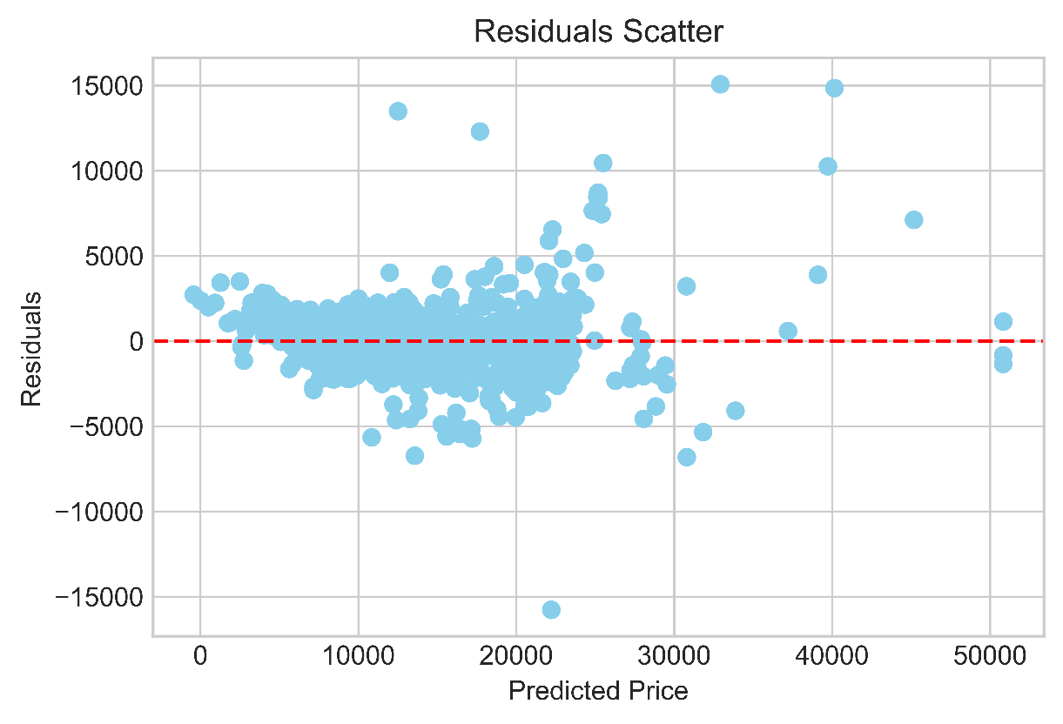
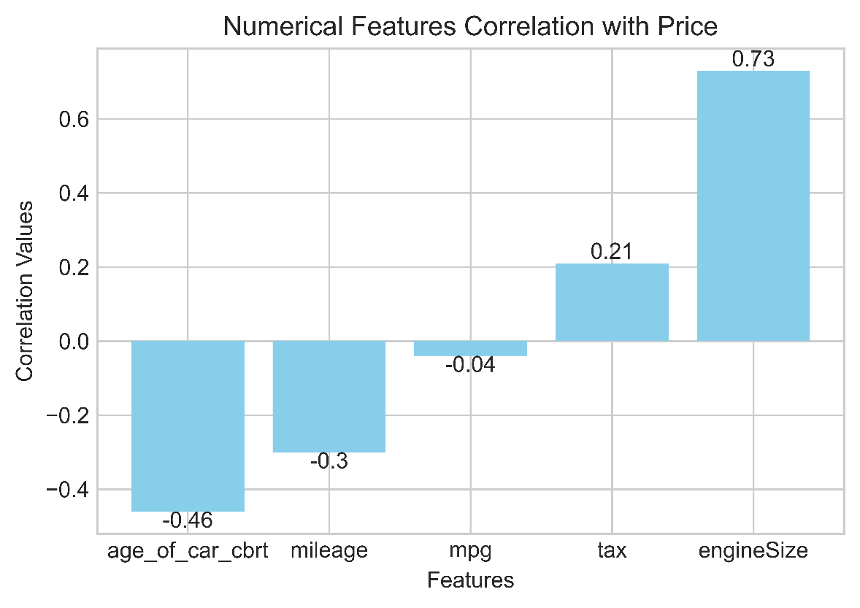
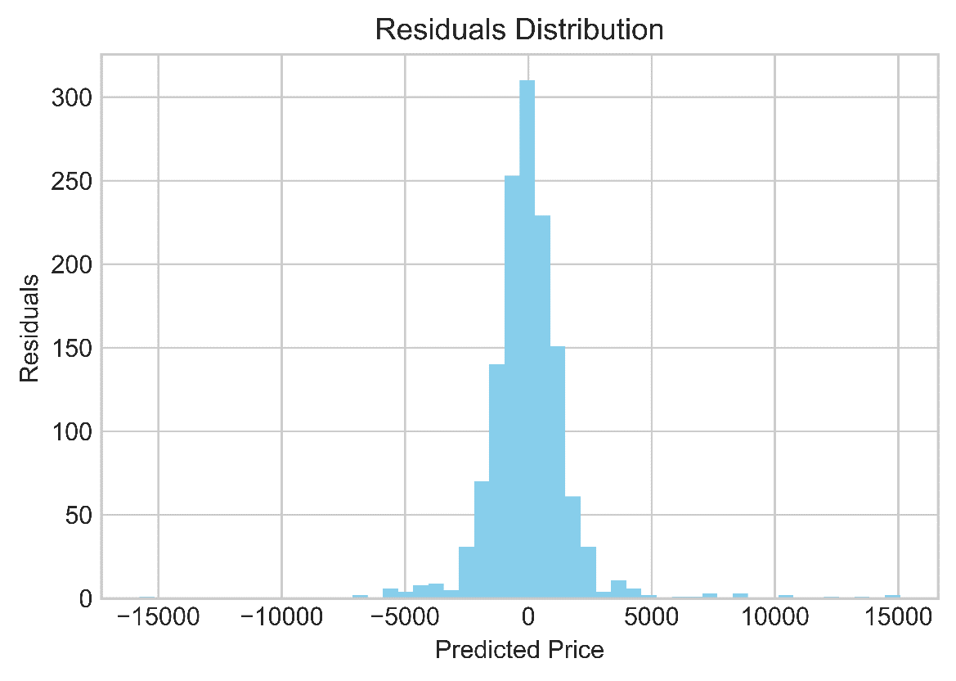
Used Car Price Prediction: A Linear Regression Model to Estimate Prices of Used Cars.
[jacobjoshua675@gmail.com]
R-squared Score
0.92
Cross Validation Scores
1 | 2 | 3 | 4 | 5 | 6 | 7 | 8 | 9 | 10
0.93 | 0.93 | 0.92 | 0.92 | 0.92 | 0.94 | 0.93 | 0.93 | 0.94 | 0.92
Observations:
92% of the variance in price is explained by the predictors.
Age of car and Mileage with negative correlations to price are also the top 2 features cutting down on price with standardized coefficients -1818 and -1282 respectively.
Evenly scattered and normally distributed residuals confirm a linear model is appropriate for this data.

Slide 2
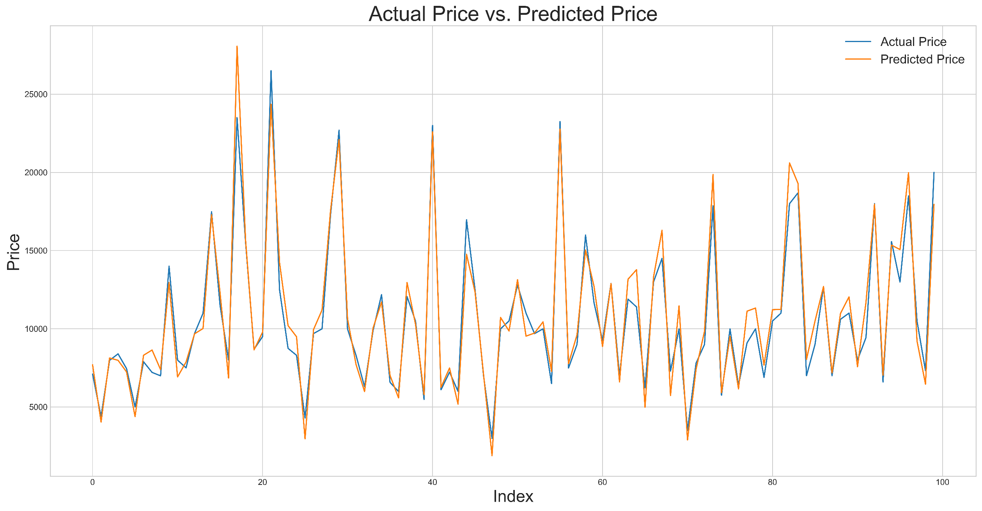
Actual vs. Predicted Price is shown only for the first 100 indexes to enhance visualization.

